Slide 1

Project Overview:
King of the Sea

Slide 2

Milestone Review
We want our game to contain :
3D models of the players
Multiple maps with dynamic levels changing with different states of the tide.
Obstacles with debuffs
The AI’s to behave differently related to the player's position
A mechanic that allows the player to change size
By mid Week [???] we aim to have models finished and a playable prototype.
We also want to have the core game mechanic working by week [???]

Slide 3

King of the Sea
3D racing game with controls for left, right, accelerate and brake
At least 2 power-ups
Minimum of 4 Opponent vehicles on track with competitive opponent AI
Dynamic events
Rating system per level based on time, including a fail state
3 balanced, fully tested playable levels in at least two locations
Consistent art style implemented with clear UI
Music and sound FX
Notes:
Power ups = Speed boost, fish food to change fish size, Spinning starfish (attack)
L> and debuffs such as plastic pollution and sea grass and fishing wire/hooks
Competitive AI that changes based on players position (and state of the tide?)
Dynamic events changing the path layout and open up / cu toff shortcuts
3

Slide 4
Elevator statement
“A 3D Stylised Sea Based Racing game with tidal mechanics, for players with a passion for the sea and Arcade Racing Games.”
Explore the treacherous ocean as one of its creatures, avoiding dynamic obstacles, compete with your friends and become the King of the sea!

Slide 5
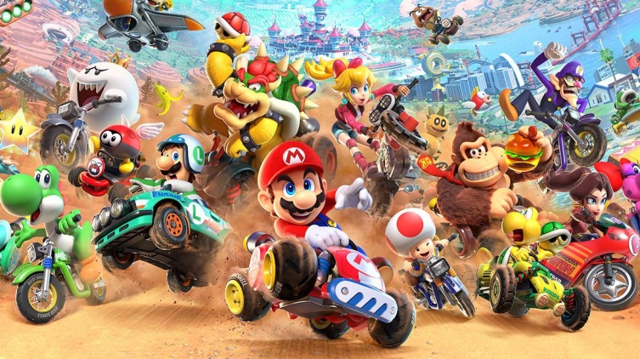
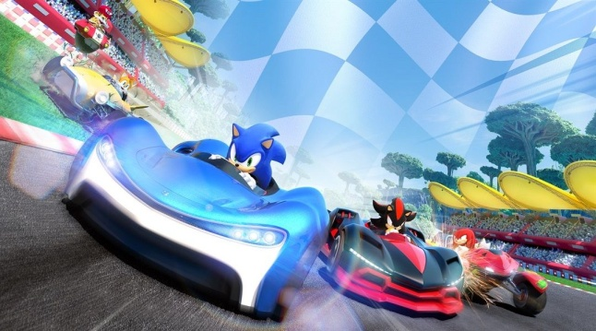
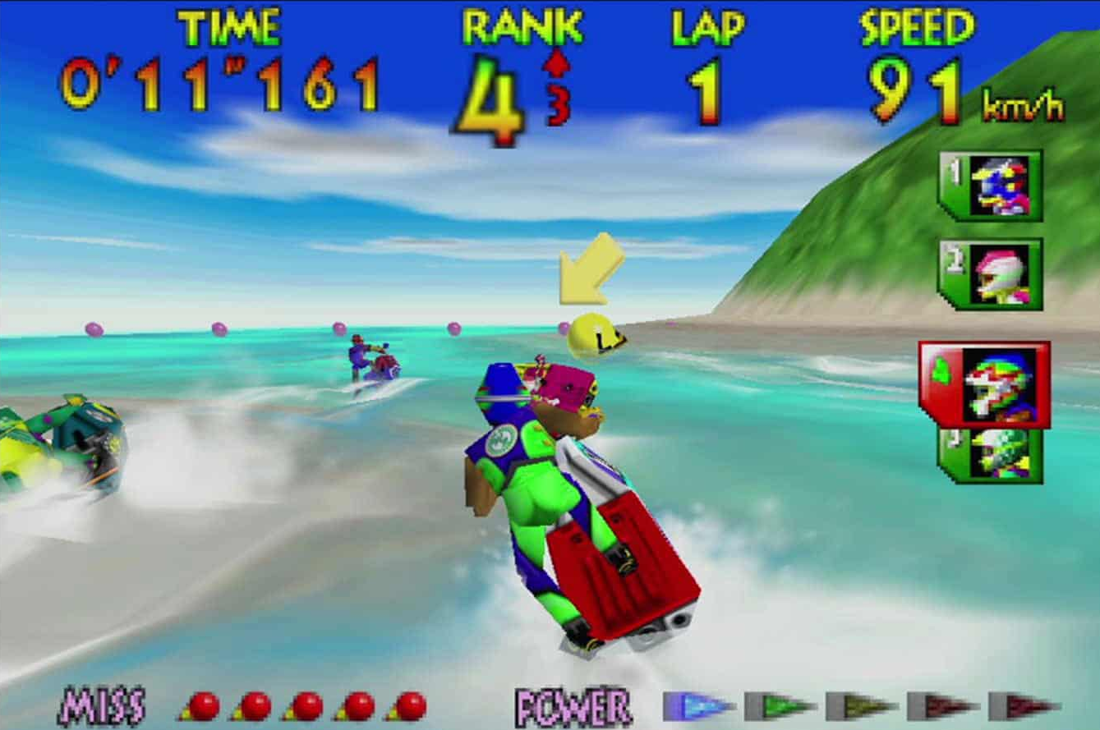
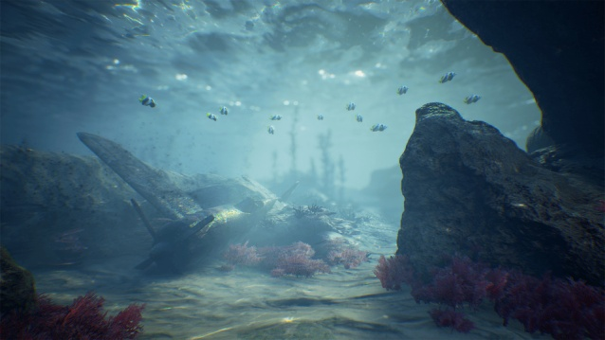
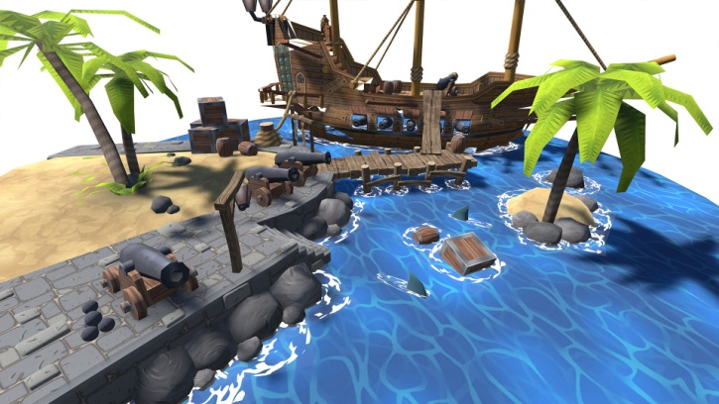
Razor statement
Our game will play like the Mario kart game series and sonic racer
Visual setting Similar to Wave Racer and Mario kart but with open oceans
Notes:
Mario kart and Sonic racer both have hidden short cuts in races , allowing players to explore tracks instead of staying to the clear path laid out Infront if them
5

Slide 6
Narrative
The Great Coral Throne has been vacant for too long.
The ocean’s spirits have decreed that whoever completes the circuit of the "Shifting Currents" surviving the changing tides, will be crowned the true monarch.
You aren't just racing; you’re proving you have the wisdom to navigate the ocean’s unpredictability.
Notes:
Mario kart and Sonic racer both have hidden short cuts in races , allowing players to explore tracks instead of staying to the clear path laid out Infront if them
6

Slide 7
Design pillars
Dynamic Events –obstacles and available Paths
Sound Design – Lots of sea and water related sound
Enemy Pathing – AI fish have different paths
Visuals – stylised 3d visuals
Notes:
Dynamic events
L> Random encounters with obstacles
L>Paths changing with the tides
Sound design
L>muffles songs to help the illusion of being underwater.
L>water swishing sounds
L>bubbes from players and plants
Enemy pathing
L> enemy moves differently depending on how well the player can play
L>enemy's have different paths from each other, so they aren’t all just taking same route. Creating rivalry during races
Visuals
L>Similar to Mario kart with cartoonish and vibrant visuals
7

Slide 8
Core mechanics
Usable Items
-starfish to launch
-Fish food (changing fish size)
-Different Fish Abilities (squid ink, pufferfish bloat, etc)
Tidal Driven Dynamic Tracks
-Tracks change as the races progress, with the changing tide
-Different current directions to speed up sections or slow them down
-New areas to discover with each state of tide, each having extra collectibles
obstacles:
Pollution
Predator Fish
Seaweed
Fishhooks and fishing lines
Points collected by:
Creating a new Fastest Time
Having Most Collectables collected in a single race
Least Damage taken by the obstacles
Notes:
Points
L>3 hit points of damage before death
Usable items
L> star fish are used as a prodjectile against other racers, each one takes a health point off the target
L> the fish food is temparary
8

Slide 9
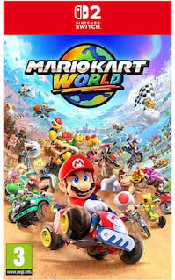
Target audience
A large age range of players can enjoy this game with it aimed more at casual players, and to be played as a house game in couch co-op
Whimsical cart racing games such as the Mario Kart series typically have PEGI 3 ratings while more realistic racing sim type games like Asphalt or Need for speed sit around PEGI 12 to 16.
Notes:
More specific age range aimed at = Mid-teens
9

Slide 10
Production tasks
Production task | RAG status | RAG%
// fill out later

Slide 11
Design tasks
Design task | RAG status | RAG%
// fill out later

Slide 12
Art tasks
Art task | RAG status | RAG%
// fill out later

Slide 13
Code tasks
Code task | RAG status | RAG%
// fill out later

Slide 14
Overall RAG status
Production | Design | Art | Code
[???]% | [???]% | [???]% | [???]%
OVERALL PROJECT RAG
[???]%

Slide 15
Design show and tell
[Some of the concept design/ maps from gem]

Slide 16
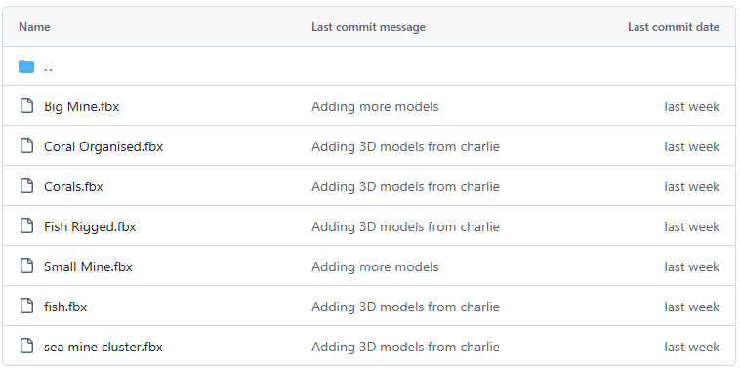
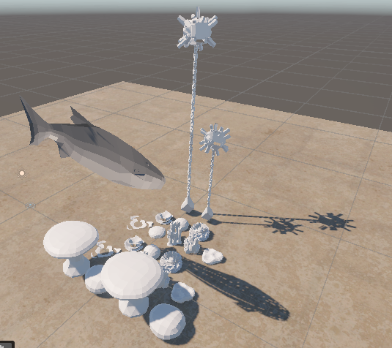
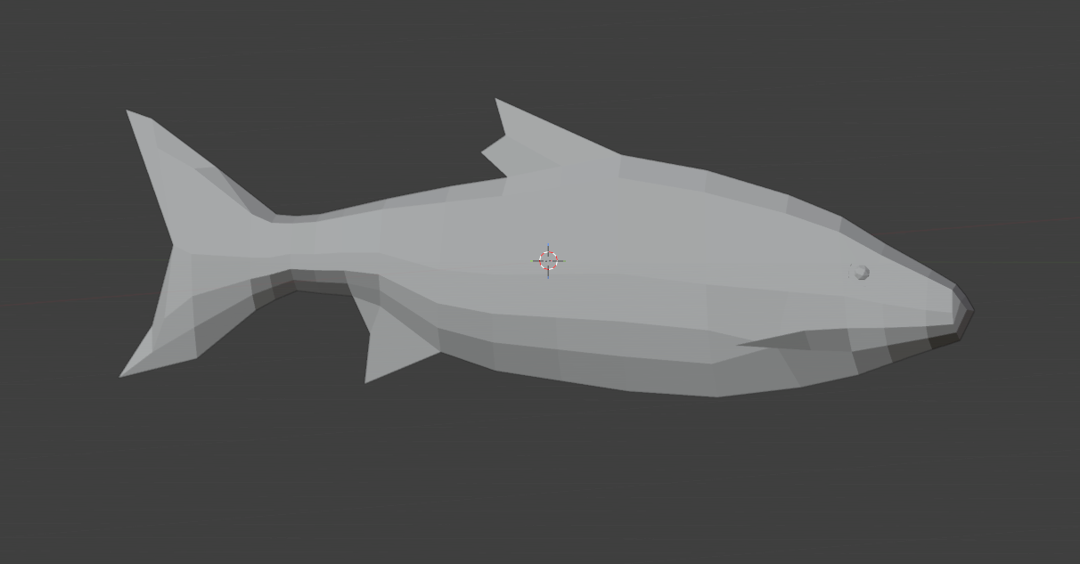
Art show and tell
[Some of the models and shit from charlie, maybe ui stuff if that’s been done]
Charlie made a fish in blender and rigged it so it’s ready to be animated by the goat (mocap) for when we start making the game
As well as working on some other 3D models

Slide 17
Code show and tell
Currently:
Initial movement similar to a submarine
Model always stays upright, no rolling like an aeroplane
Rigid, but accurate mobility
Eventually:
Acceleration, breaking, ‘physics’
More dynamic camera

Slide 18
Tasks for next week
Production | Design | Art | Code
// fill out later

Slide 19
Thank you.
any questions?

